Slide 1
Performance analysis framework for base station placement using IEEE 802.11
Group study presentation
18.03.2020
Kirill Kukartsev
Zufar Makhmutov
Rustam Khakov
Notes:
Kirill

Slide 2
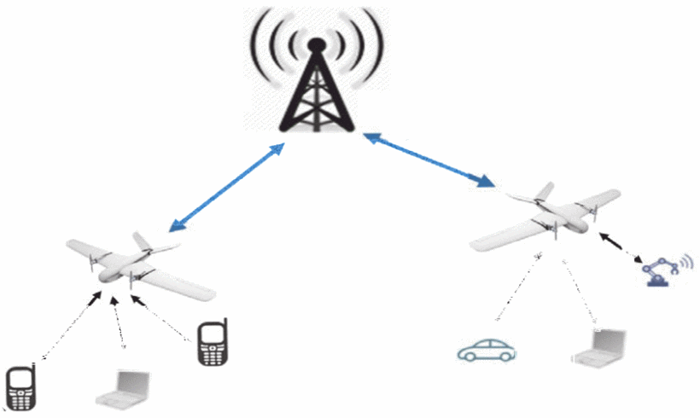
Problem Description
Mobile users’ demand increasing
Higher speed, lower latency
More data and services
Tendency to be located closely to users
2G: Macro-cells
3G - 4G: Micro-cells
5G: Pico-cells
Idea: Unmanned Aerial Vehicle with Base Stations (UAV-BS)
Problems:
How to design a placement algorithm?
How to evaluate correctness the algorithm?
How to test the algorithm in the real life?
How to coordinate the elements of mobile communication system infrastructure?
Increasing coverage and capacity
with UAV equipped with base stations, source
Notes:
Kirill

Slide 3
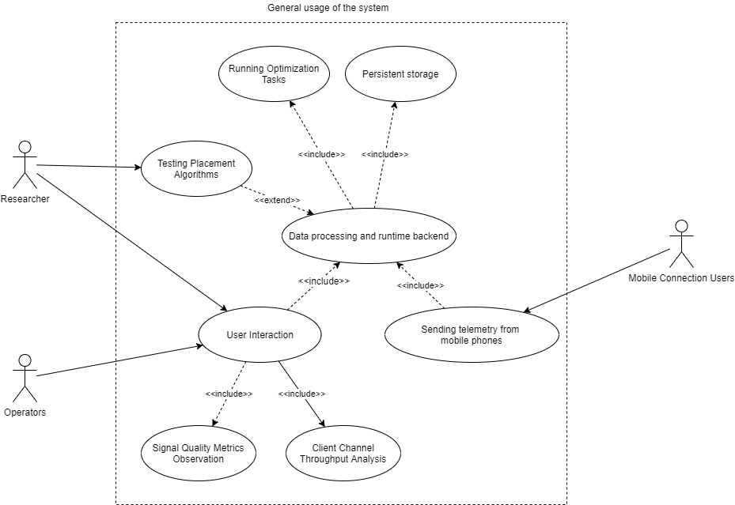
A general use-case for possible solution
A generalized use-case for a placement algorithm experimental framework
Notes:
Kirill

Slide 4
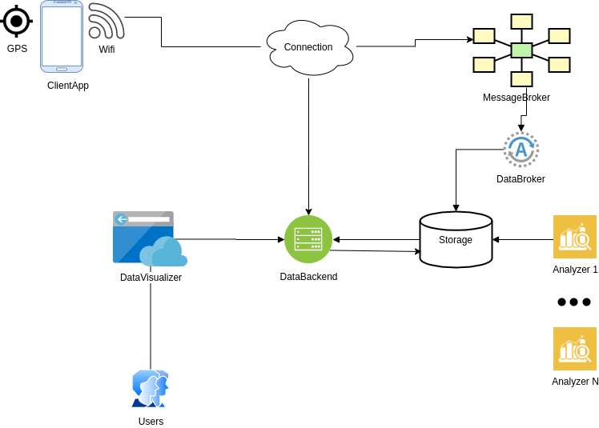
Abstract System Design
Abstract Design for component interaction for the given possible problem solution
Notes:
Rustam

Slide 5
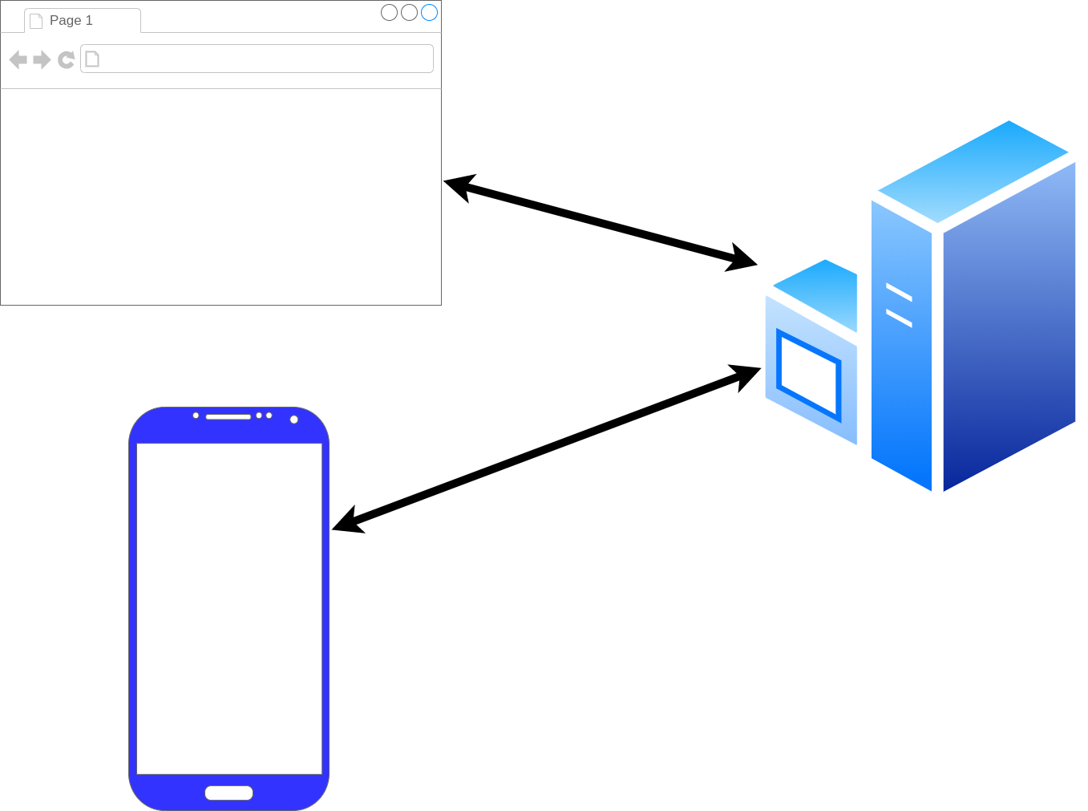
Framework Architecture Description
GPS_Frontend
GPS_Tracker
GPS_Android
Three main component of framework: a phone (GPS_Android), user interface (GPS_Frontend), data processing (GPS_Tracker)
Notes:
Rustam

Slide 6
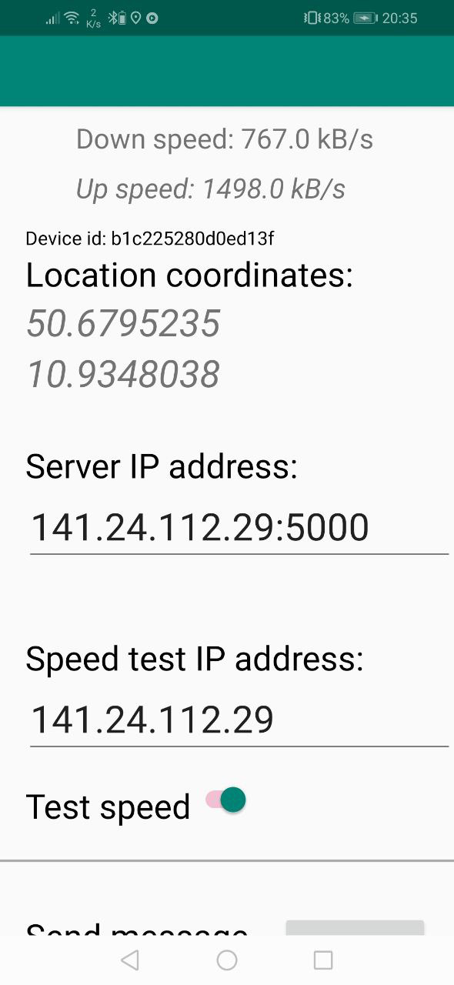
Android Component
Measure:
GPS location
Wifi connection
Connection speed using given server by MQTT or HTTP
Activities:
Send measurment result to given server
Measure data periodicaly with given timeout on background
GPS_Android installed on an Android SmartPhone
Notes:
Rustam

Slide 7
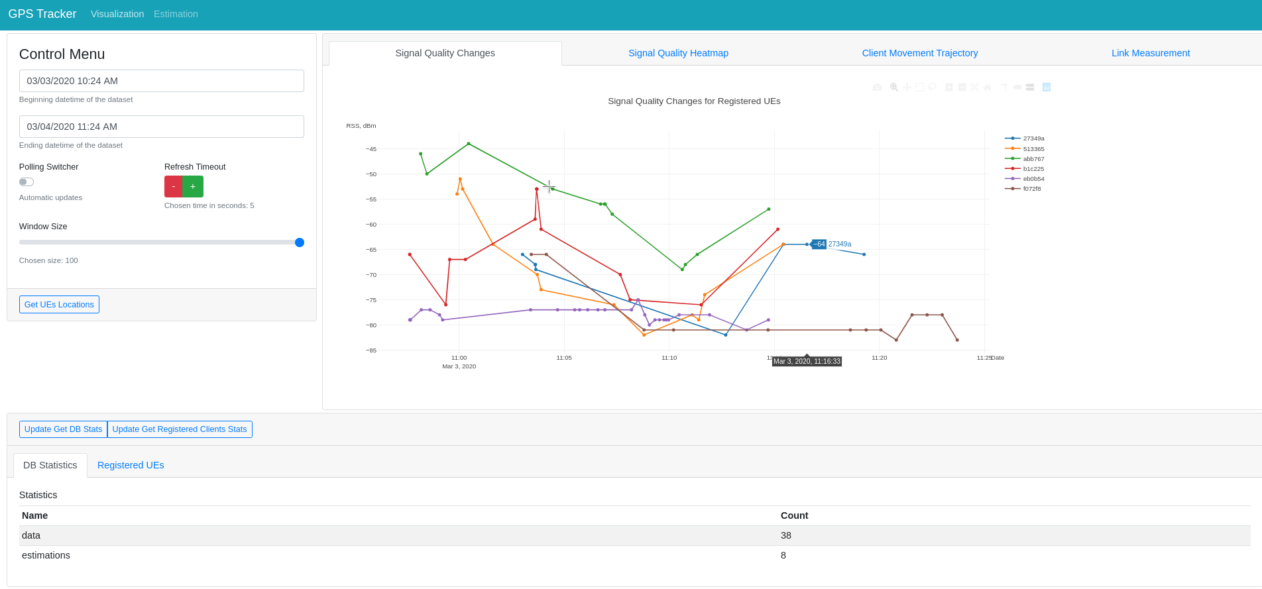
UI Component
Timeframe,
update
frequency
configuration
Location data on given
timeframe
Database
statistics
Layout of the UI implemented by GPS_Frontend. The user interact via a web-browser.
Notes:
Rustam

Slide 8
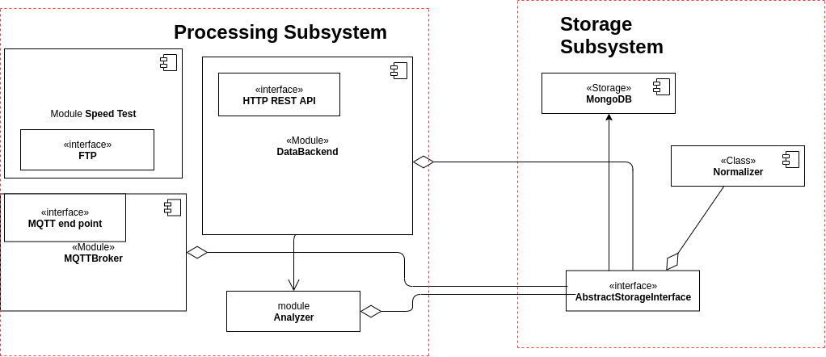
Backend Component
Component diagram for GPS_Tracker backend components.
Notes:
Rustam

Slide 9
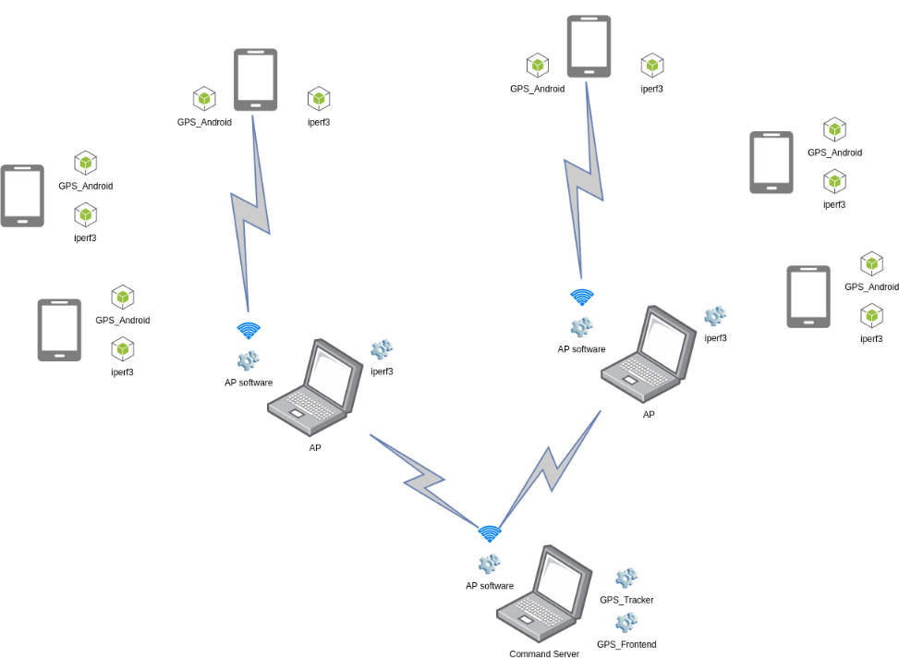
Experiment Description
Communication between components during the experiment
Notes:
Zufar

Slide 10
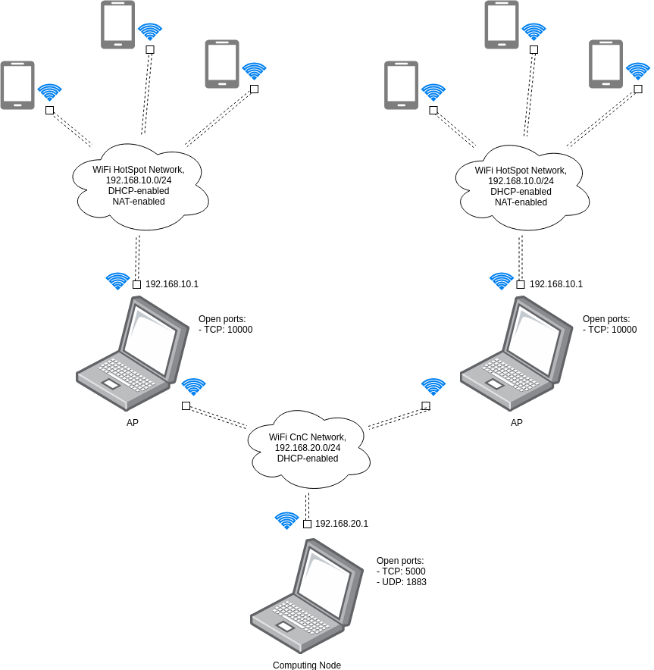
Network Diagram of Experiment
A network scheme of experiment
Notes:
Zufar

Slide 11
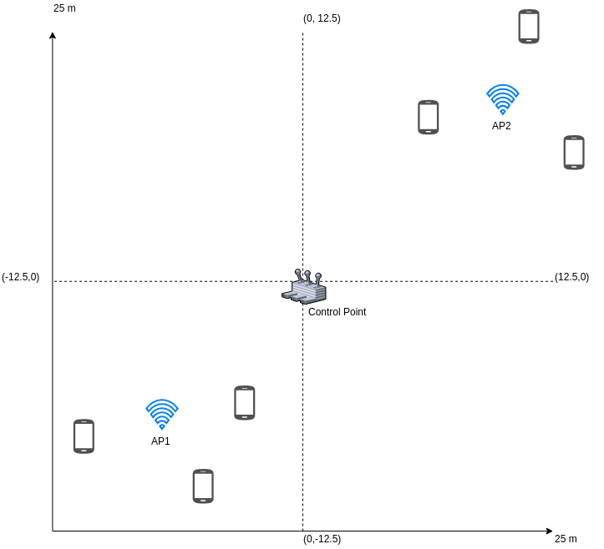
Sub-Optimal Case
Notes:
Zufar

Slide 12
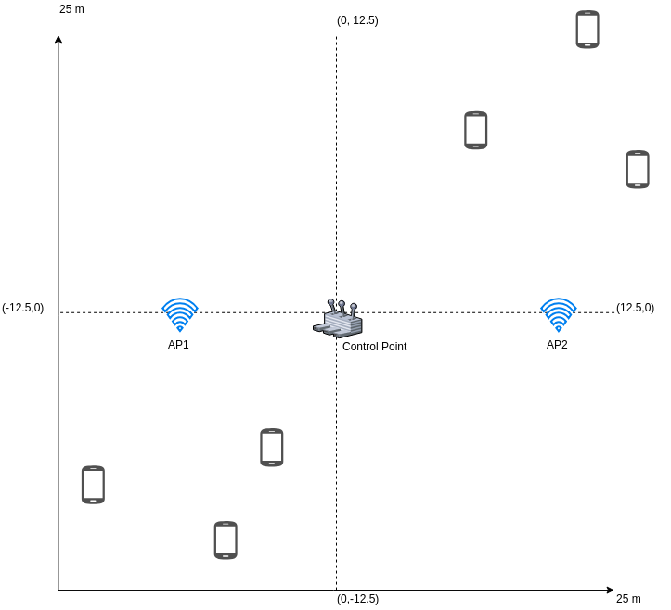
Uniform Case
Notes:
Zufar

Slide 13
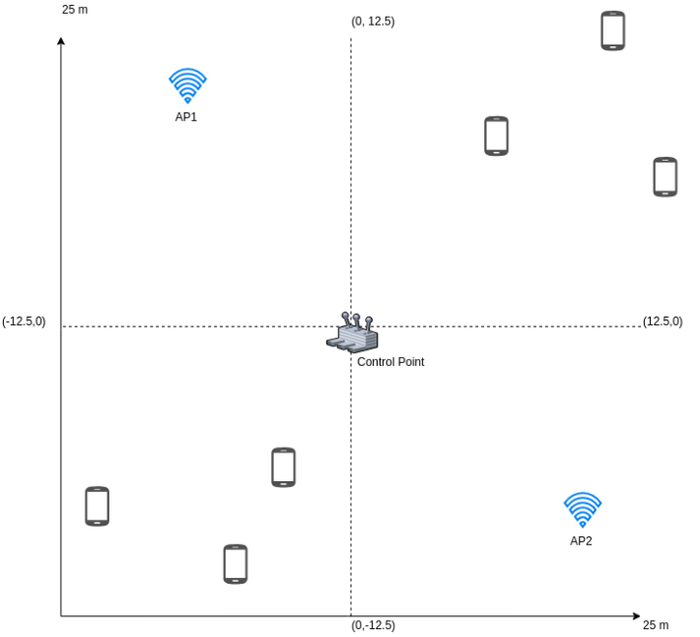
Near-Uniform Case
Notes:
Zufar

Slide 14
Experiment 1
Goals:
initial try
as many UEs as possible
collect errors
Conditions:
6 UEs, 1 CnC, 2 APs
cloudy sky, snow on the ground, -1 .. +1 °
Decisions:
resolve the second AP failure reasons
add logs to UEs

Slide 15
Experiment 2
Goals:
check new speed estimation algorithm
discover UEs errors using logs
better track overall changes in front-end
Conditions:
3 UEs, 1 CnC, 1 APs
clear sky, no snow, strong winds
Decisions:
add logging to APs as well
implement direct HTTP requests

Slide 16
Experiment 3
Goals:
compare HTTP requests instead of MQTT
completely refactored app
Conditions:
3 UEs, 1 CnC, 1 APs
indoor (TU Ilmenau Mensa building)
Decisions:
one more scaled-up experiment
run placement algorithm

Slide 17
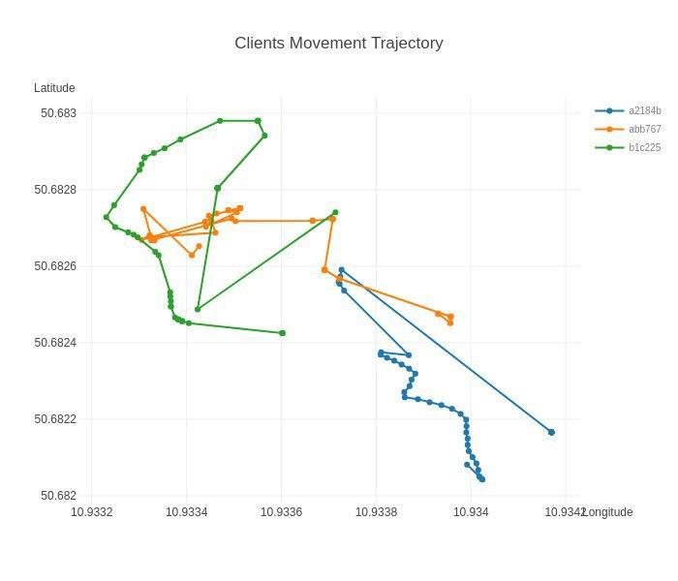

Slide 18
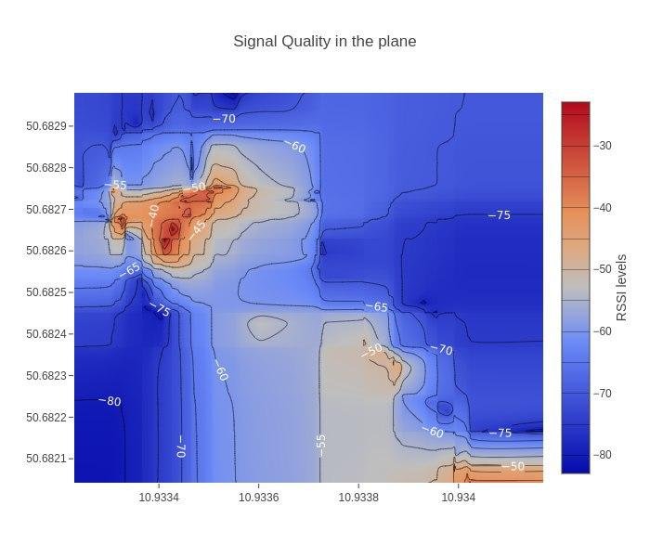

Slide 19
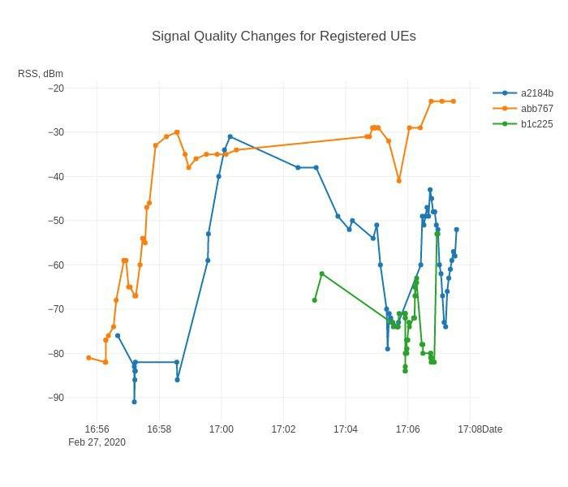

Slide 20
Experiment 4
Goals:
three cases (sub-optimal, uniform, near-optimal)
run placement algorithm
Conditions:
6 UEs, 1 CnC, 2 APs
light rain
Decisions:
analyze collected data
figure out why 2 UEs positions were wrong

Slide 21
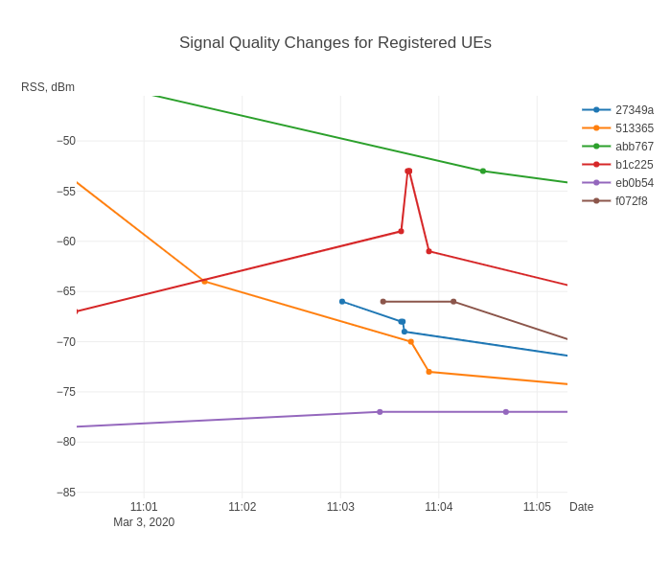

Slide 22
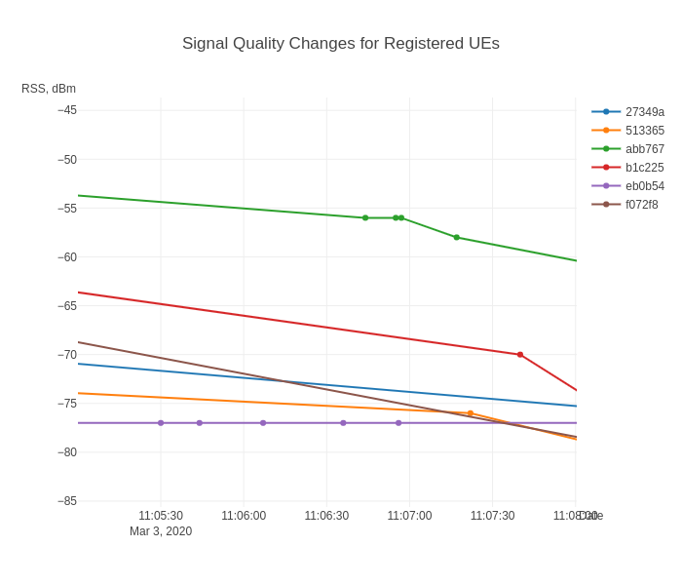

Slide 23
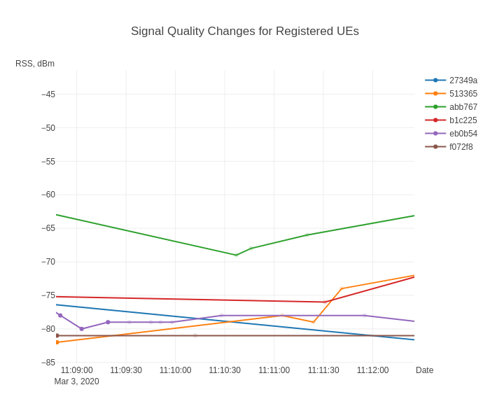

Slide 24
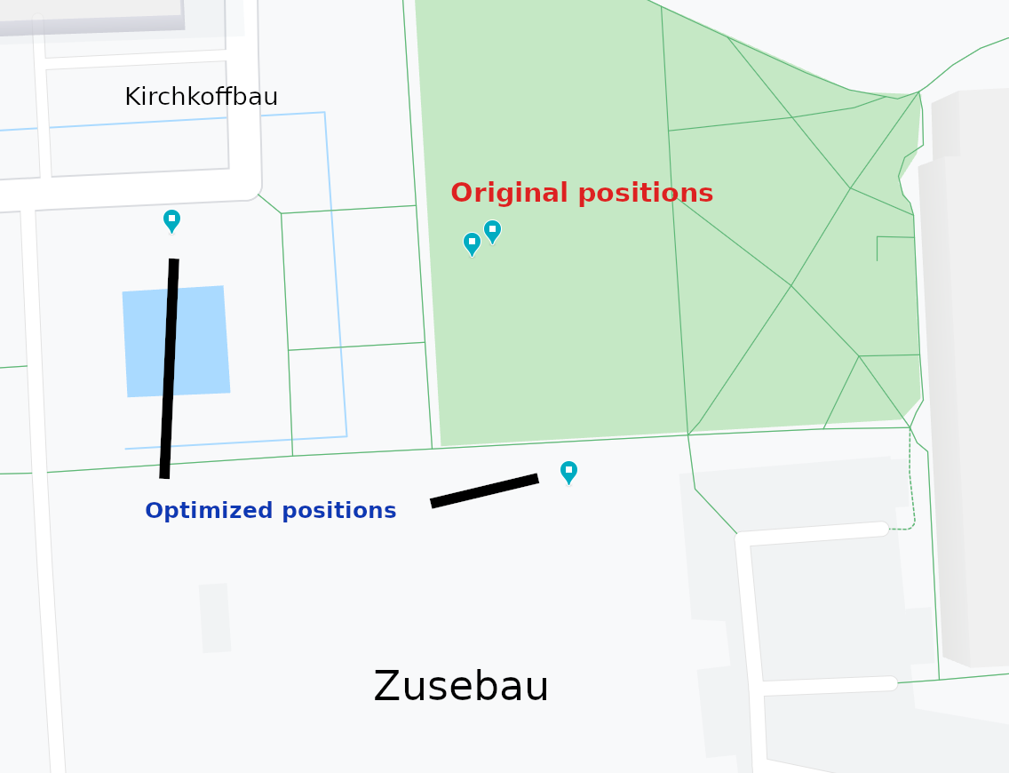
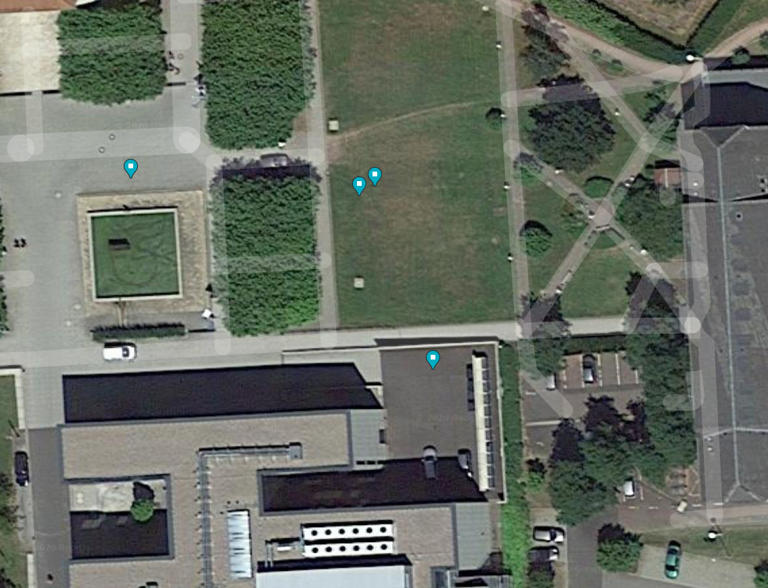
Optimized positions for UAV-BS
Logical map for the original position and suggested optimized position. Coordinates by “clustering” (K-Means) position optimization algorithms are highly biased.
Satellite map with original and suggested positions for UAV-BS layout
Notes:
Zufar

Slide 25
Final result
Are the initial aims fulfilled?
 | Aspect | Result
Developed system | Functional properties | Works as expected, but had to alter architecture
 | Stability / Performance / Usability | Link may suffer collisions
Optimization algorithm | Provided positions | Calculated correctly
 | Stability / Performance / Usability | Extra data and/or other algo for higher accuracy
Result of 4 performed experiments
Notes:
Zufar

Slide 26
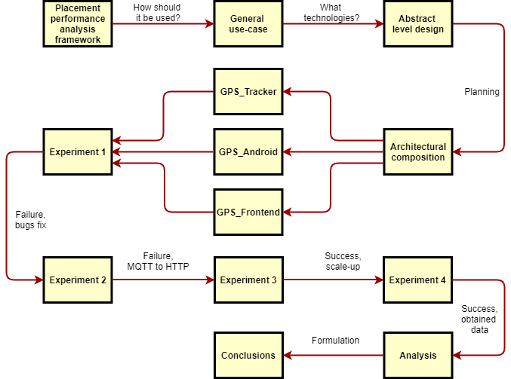
Overview
Notes:
Zufar

Slide 27
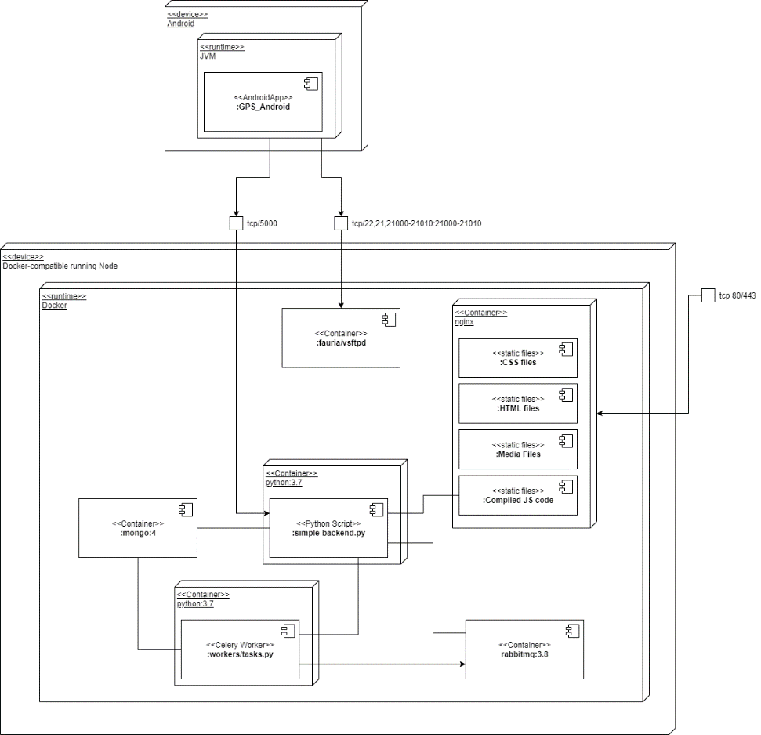
Appendix. Deployment Diagram of Framework
Dockerized infrastructure
Unified interface
Configuration in .config or OS env
A deployment case in container runtime.
Notes:
Kirill

Slide 28
Appendix. Resolved problems
Table describes significant moments of workflow
Problem | Group | Resolved way
Can’t install app via apk | Android | Install using Android Studio
Data doesn’t come to CnC | Wi-Fi | Check AP
Silent crash of app | Android | Added logging to file in phone
Error related to MQTT | Software | Replace MQTT with HTTP
Hard to describe software architecture | Report | Refactor code to follow MVVM pattern
Notes:
Zufar

Slide 29
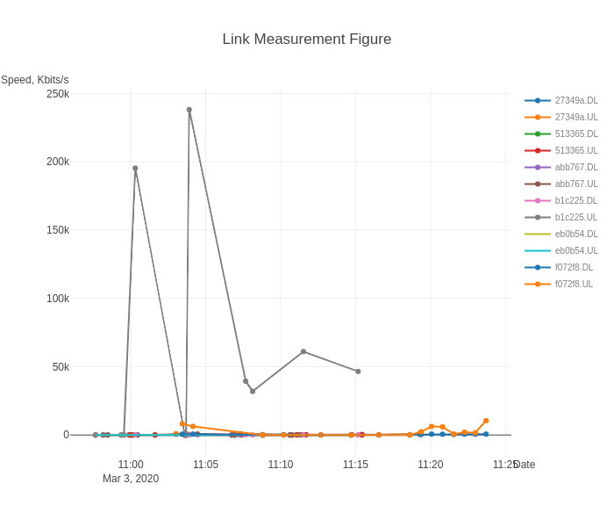
Appendix. Experiment 1/4
Measured signal link speed for uplink and downlink. Mostly metrics are degraded, cannot truly rely on them.
Notes:
Zufar

Slide 30
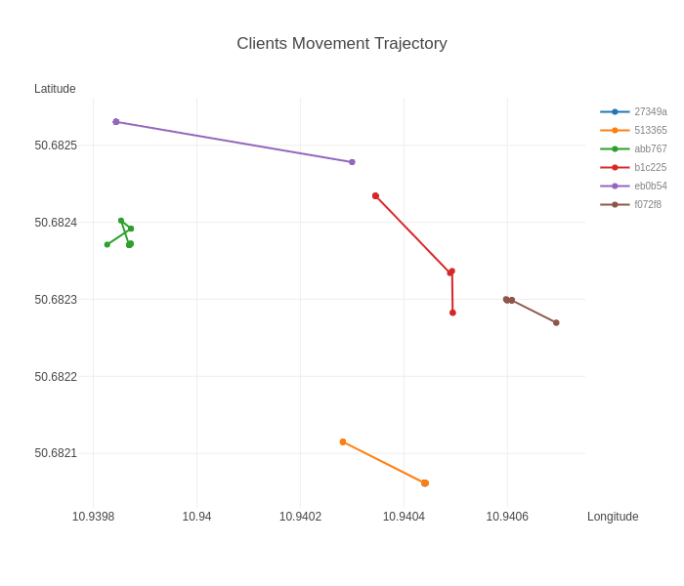
Appendix. Experiment 2/4
Overall detected coordinates changes during the experiment. Clearly shown that GPS has measurement error.
Notes:
Zufar

Slide 31
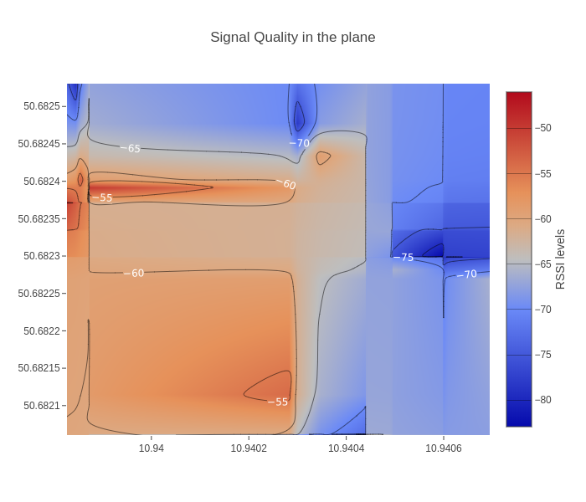
Appendix. Experiment 3/4
The heatmap of quality of WI-FI signal by GPS coordinates.
Notes:
Zufar

Slide 32
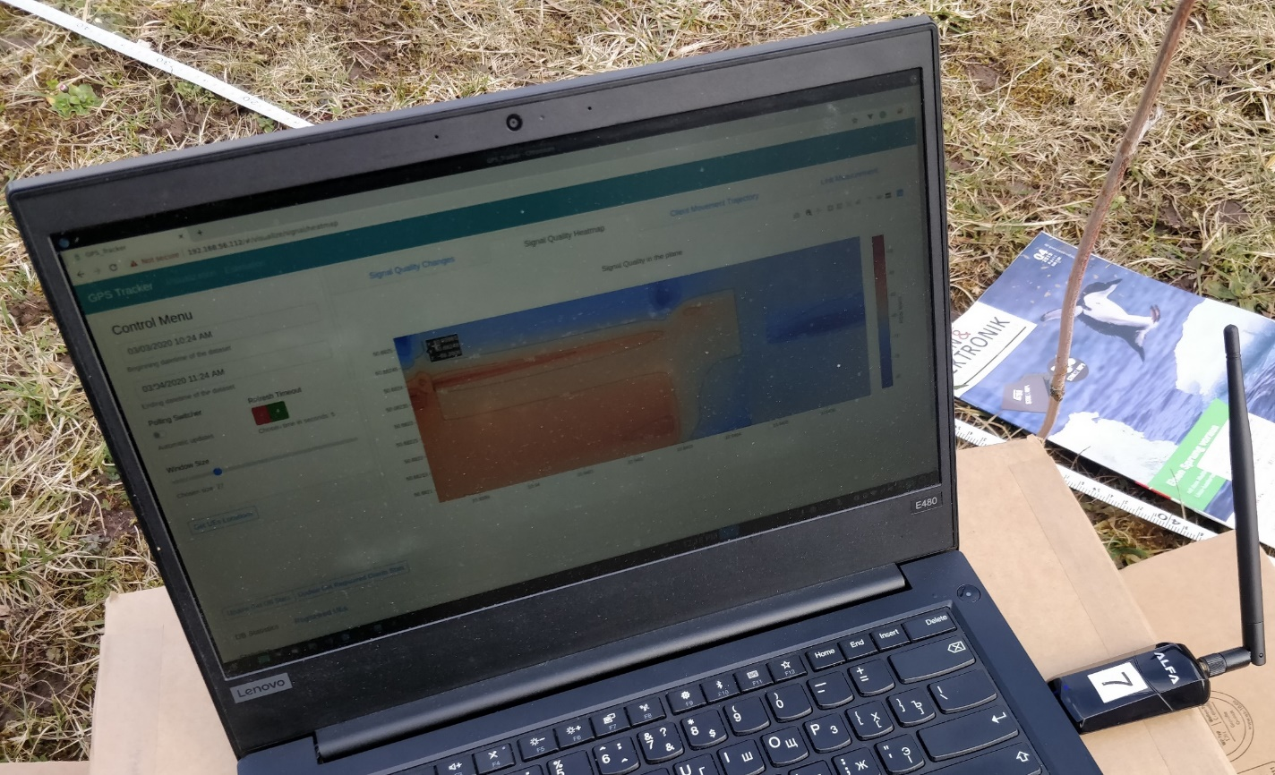
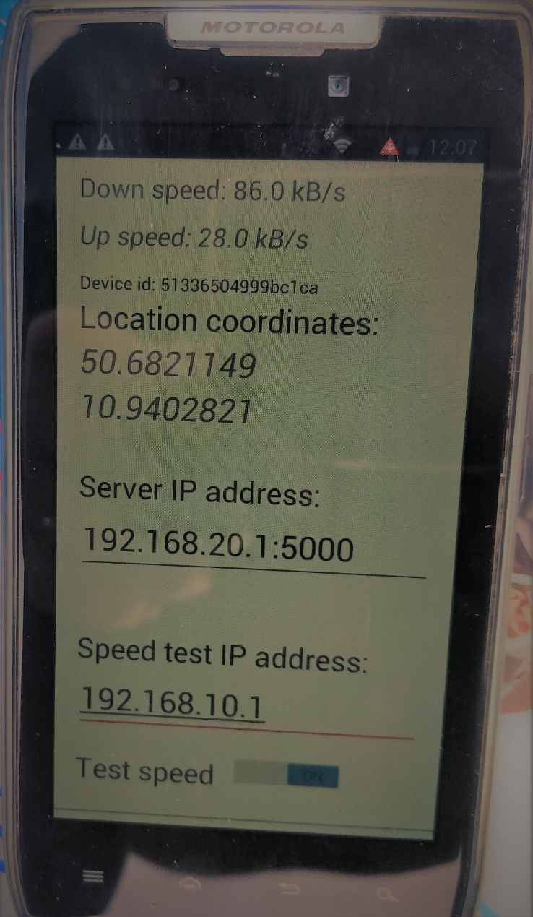
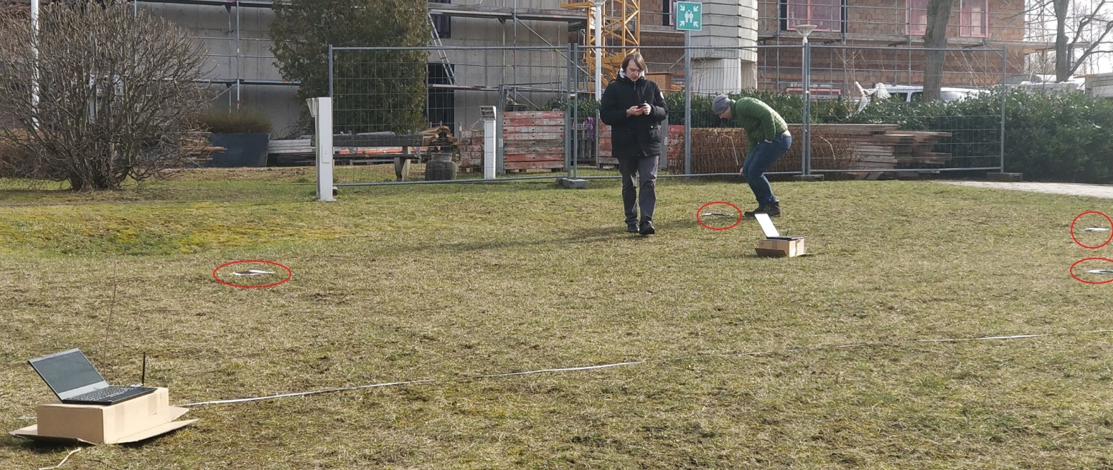
Appendix. Experiment 4/4
Notes:
Zufar

